Slide 1
Nazifa Alam Nurin Id. 193002103 Department of CSE CSE-201 Presentation on Internet-of-things- (IOT)

Slide 2
Plan of Presentation
What is IoT?
How IoT Works?
The Structure of IoT
Current Status & Future Prospect of IoT
IoT as a Network of Networks
Few Applications of IoT
TECHNOLOGICAL CHALLENGES OF IoT
References References

Slide 3
What is IoT?
The Internet of Things (IoT) is the network of physical objects or "things" embedded with electronics, software, sensors, and network connectivity, which enables these objects to collect and exchange data.
The concept of the Internet of Things first became popular in 1999, through the Auto-ID Center at MIT and related market-analysis publications. R Radio-frequency identification (RFID) was seen as a prerequisite for the IoT at that point.

Slide 4
How IoT Works?
Internet of Things is not the result of a single novel technology; instead, several complementary technical developments provide capabilities that taken together help to bridge the gap between the virtual and physical world.
These capabilities include:
Addressability
Identification
Sensing
Actuation Embedded information processing
Localization
User interfaces

Slide 5
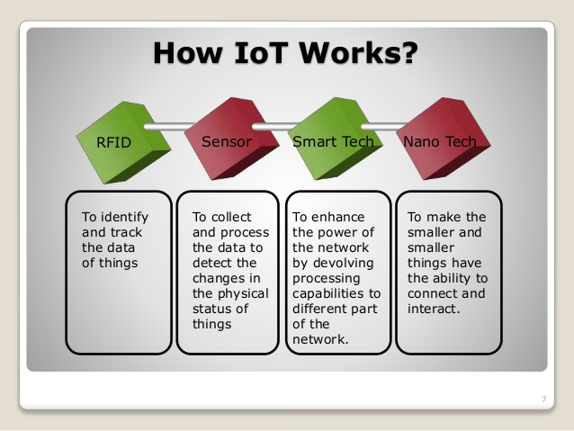

Slide 6
The Structure of IoT
The IoT can be viewed as a gigantic network consisting of networks of devices and computers connected through a series of intermediate technologies where numerous technologies like RFIDs, wireless connections may act as enablers of this connectivity.
Tagging Things : Real-time item traceability and addressability by RFIDs.
Feeling Things : Sensors act as primary devices to collect data from the environment.
Shrinking Things : Miniaturization and Nanotechnology has provoked the ability of smaller things to interact and connect within the “things” or “smart devices.”
Thinking Things : Embedded intelligence in devices through sensors has formed the network connection to the Internet. It can make the “things” realizing the intelligent control.

Slide 7
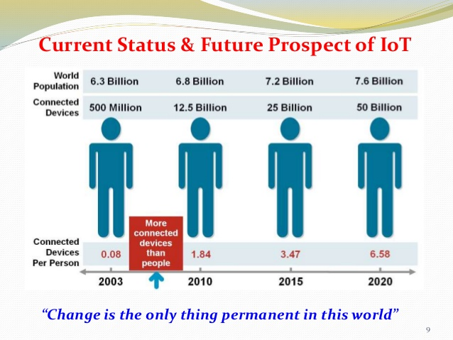

Slide 8
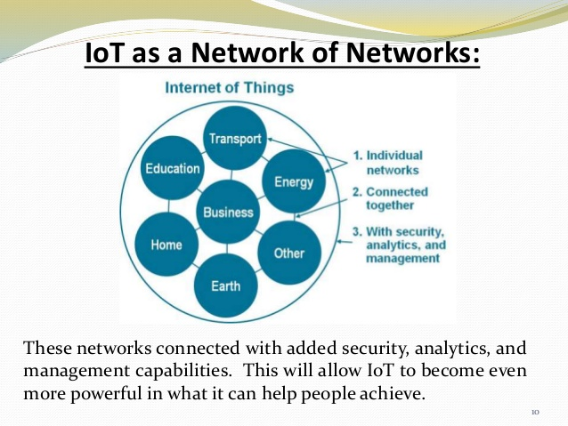

Slide 9
Few Applications of IoT
Building and Home automation
Manufacturing
Medical and Healthcare systems
Media
Environmental monitoring
Infrastructure management
Energy management
Transportation
Better quality of life for elderly

Slide 10
TECHNOLOGICAL CHALLENGES OF IoT
At present IoT is faced with many challenges, such as:
Scalability
Technological Standardization
Inter operability
Discovery
Software complexity
Data volumes and interpretation
Power Supply
Interaction and short range communication
Wireless communication
Fault tolerance

Slide 11
References
1. www.google.com
2. https://en.wikipedia.org/wiki/Internet_of_Things
3. Cisco whitepaper, "The Internet of Things" - How the Next Evolution of the Internet Is Changing Everything, by Dave Evans, April 2011.
4. GE cloud expo 2014, "Industrial Internet as a Service", by Shyam Varan Nath, Principal Architect.
5. Dr. Mazlan Abbas, MIMOS Berhad, Wisma IEM, Petaling Jaya

Slide 12
THANK YOU

